Slide 1

MY LIFE MY RULES
SAMEE(ROSY)

Slide 2


MY FAVORITE BOOKS THE SECRET MIRACLE MORNING ATOMIC HABITS THE ALCHEMIST THE NOBLE JOURNEY RICH DAD POOR DAD

Slide 3
SUCCESS
TO GET SUCCESS IN YOUR LIFE FIRST SAVE YOURSELF, BUILD YOUR EMPIRE,SECURE YOUR FOUNDATION,MAKE YOURSELF SO POWERFUL.

Slide 4
GRATITUTE
BEING THANKFUL IS GREATEST ONE ..BE KIND BE THANKFUL TO WHAT YOU ALL GET IN YOUR LIFE..

Slide 5
SORRY
STOP SAYING SORRY, REPLACE YOUR SORRY WITH A THANK YOU, INSTEAD OF SAYING A’M LATE, SAY THANK YOU FOR WAITING..IF YOU TALK TOO MUCH ,SAY THANK YOU FOR LISTENING…

Slide 6
“LIFE CONSIST IN WHAT A MAN IS THINKING OF ALL DAY” - RALPH WALDO EMERSON.

Slide 7
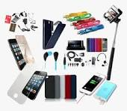
AVOID SPENDING TIME ON GADGETS

Slide 8
PERFECT
NO ONE IS PERFECT NOT ME, NOT YOU, NOT THEM. IF YOU WANT TO LIVE A PEACEFUL LIFE, ACCEPT YOURSELF FOR WHO YOU ARE, AND RESPECT OTHERS FOR WHO THEY ARE…..

Slide 9

BE HAPPY
WITH WHAT YOU HAVE

Slide 10
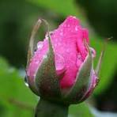
THANK YOU FOR WATCHING
TATA…..

